Slide 1


NASA Direct-STEM
Linear Regression Modeling
Isaac Cano
David San
Davis Louie
Faculty Advisor: Dr. Jiang Guo

Slide 2
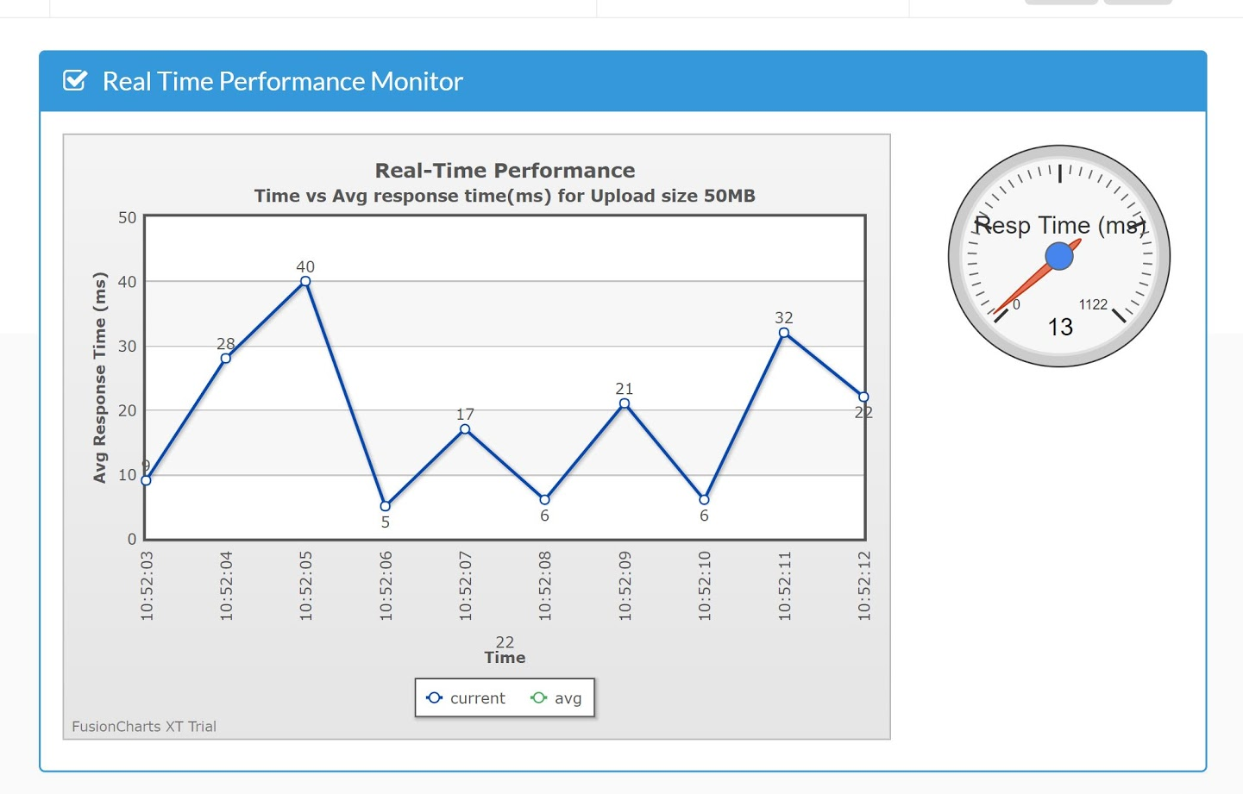
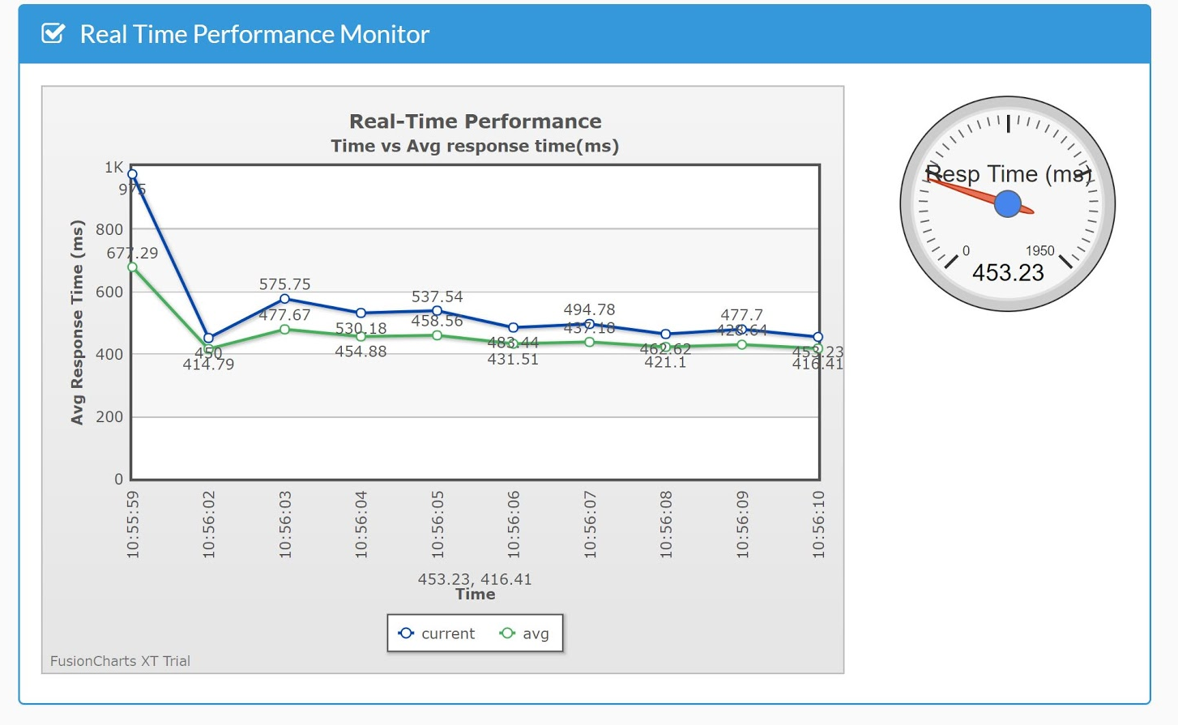
Our Project
Performance of Evaluation for Cloud Service
Web services are software that utilize access to the internet
Analyzes how well a cloud service performs
Performance
Reliability
Availability
Scalability
Capable performance testing between multiple domains:
Compares the response times between each domain
domain1.com vs domain2.com vs ... domainN.com

Slide 3
What is Pinging?
To send an echo-request packet to (an IP address) and use the echo reply to determine whether another computer on the network is operational and the speed at which the data is being transferred
In simpler terms, Pinging means to check the connection between two networks
The goal is to predict how long it takes to ping to a specific server and receive a reply
The time is generally given at the end in the measurement of milliseconds

Slide 4
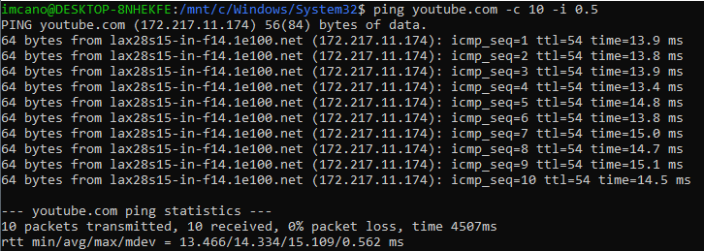
How to Collect and Record Ping Data
Through a command line:
ping youtube.com
Add parameter options:
-c, -w, -i etc.
Now, what do we need to record?
Pen and paper
Patience
Make sure to have coffee! (very important)

Slide 5
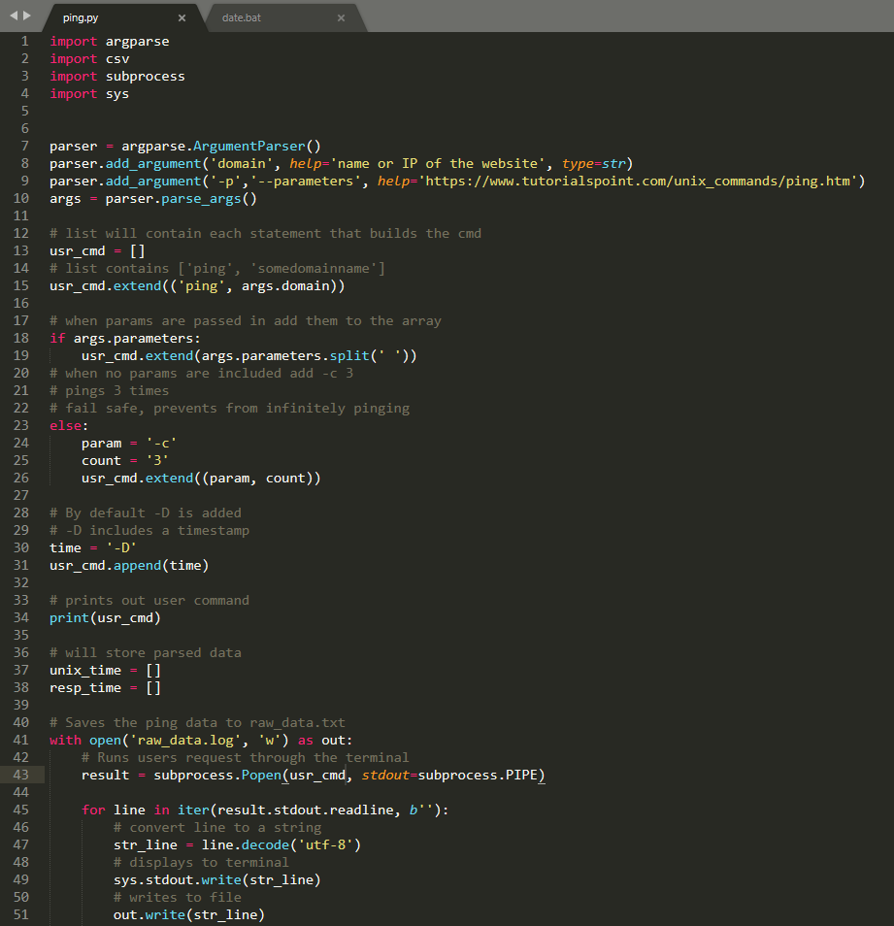
How can we make this easier?
We can automate it
Write a python script
Run the command
Save the information to text file
Organize the information
What can we do with all this data?
Graph
Analyze
Predict

Slide 6
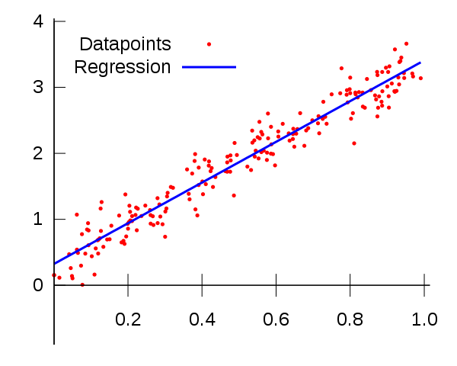
What is Linear Regression
Linear Regression is a modelled relationship between an independent variable (x-axis) and a dependent variable (y-axis)
The linear regression is determined to be a best fit line based on data points from a graph
Generally this formula can follow the form: Y = mx + b (slope-intercept form!)

Slide 7
How is it Useful?
Linear regression can be used to predict the next outcome with respect to the independent variable
We can then test the accuracy of these results by comparing them to its real value
Example: Ping for youtube.com at 1:30pm on Friday
The model predicted the ping was 150ms
The actual ping was 15ms

Slide 8
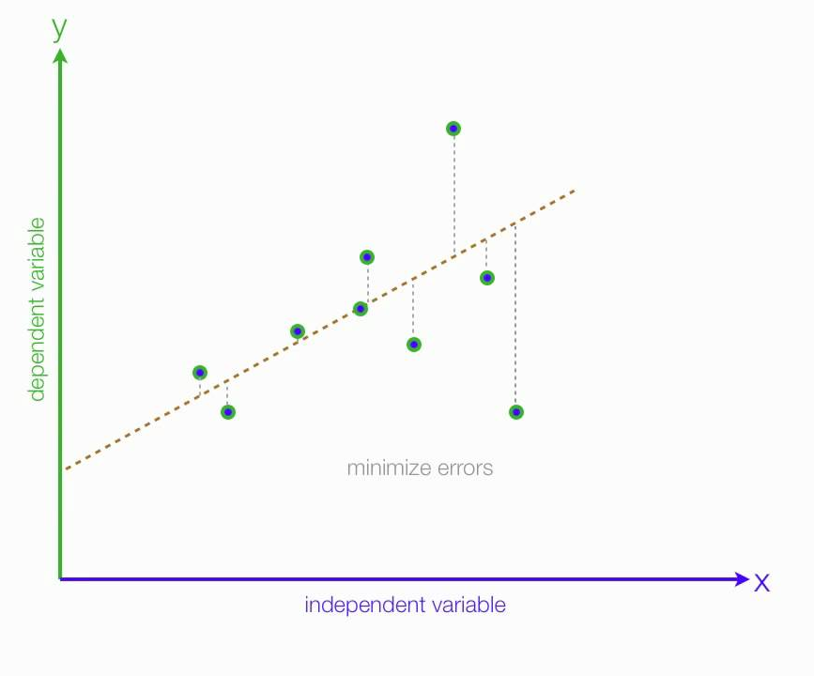
Making a Linear Regression Graph
What you need:
A Computer!
A Computer Science Major named Isaac
Ubuntu Bash (mandatory with Isaac’s implementation)
Anaconda, Excel, or Google Sheets
Python (version 3.6+)
Data (CSV file)
Jupyter Notebook (optional)
Visual Studio Code (optional)

Slide 9
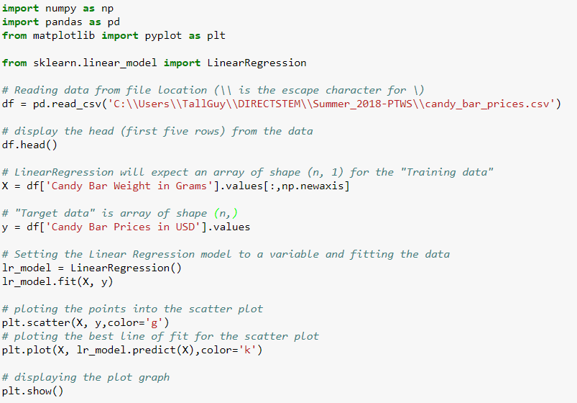
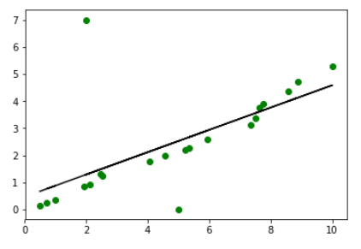
Linear Regression Python Example

Slide 10
Things to Consider
Ping different sites and graph a linear regression line for each for visual
Calculate the average ping time for each site
Obtain different ping results throughout different times of the day
Similarly, obtain different ping results for different days
How often should you ping for reliable data?
When should we use Logistic Regression?
www.yahoo.com, www.ibm.com, www.google.com, www.intel.com, www.amd.com, www.ge.com, www.cisco.com, www.twitter.com, www.facebook.com

Slide 11

Thank you & Questions
Notes:
Awwwww, you got rid of dr guo

